Slide 1

DUPLICATE CONTENT IN E commerce
PRESENTED BY
TESHIYA JOHN J

Slide 2


PROBLEM STATEMENT
One of the important factors which affect the search engine rankings of the websites is duplicate content. Products in e-commerce sites are presented in categories and sub-categories that generate multiple URLs pointing to practically the same product page. Depending on how your e-commerce website is structured, ugly, and non-readable URLs are generated for each instance of a product page. If these instances get indexed by search engines, they will be treated as internal duplicate content or meta-data – which could get your website penalized in search result

Slide 3


SOLUTION
Here are tips and best practices that will help you deal with duplicate content:
Areas that may create duplicate content such as category pages, sub-category pages, tags and archives can be excluded from indexing through the /robots.txt Robots Exclusion Protocol .
Reviews, comments and shopping carts in e-commerce sites usually create new URLs depending on how your website is structured. These pages as well as other duplicate pages generated can be excluded from being indexed by using the canonical tag or have only a single canonicalized version of the page at your website’s root .
New URLs generated that make links point to a seemingly duplicate content can be embedded with the nofollow attribute.

Slide 4
OBJECTIVE
To understand the technical issues in ecommerce websites.
.
.
List out solutions to some of the problems.
.
.

Slide 5

RECOVERY
It is a plan that helps protect your important applications and data in case of unexpected events.
.
.
.
Identify important data
Choose a backup solution
Set up replication
Test the plan regularly
Document and train the team

Slide 6

RECOVERY TESTING
Identify the critical applications and data
Set up a separate environment
Restore the necessary data
Validate the functionality
Monitor and access
Document

Slide 7


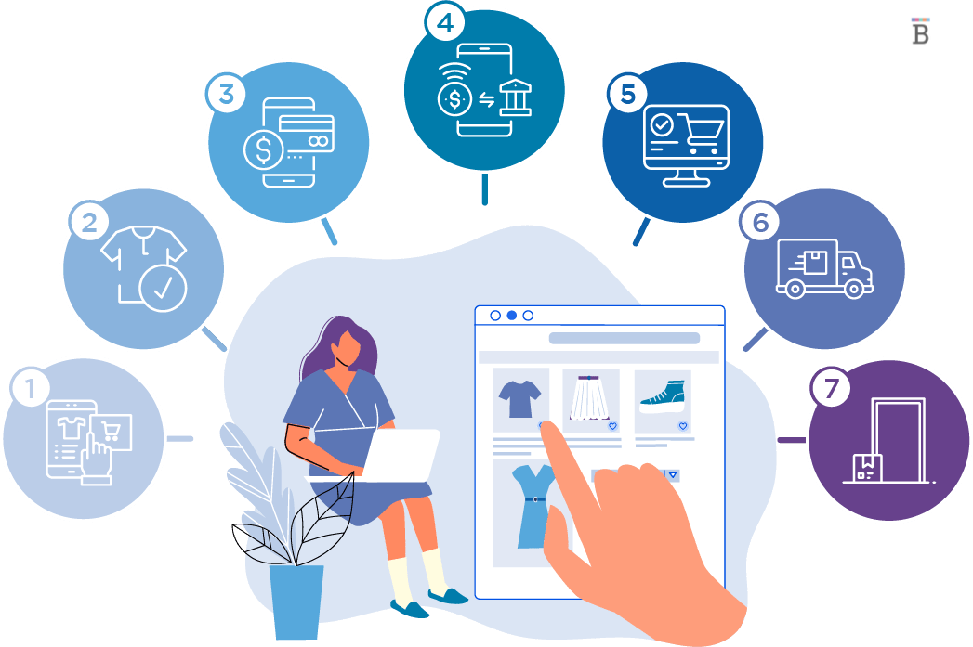


Business Continuity
Backup and restore
High availability
.
.
.
..
Monitoring
Security

Slide 8
We can conclude that duplicate content can have a severe adverse impact on the search rankings of your eCommerce site. You can identify the types of duplicate content and follow the strategies mentioned above to steer clear of duplicate content issues. Make your eCommerce site stand out. Identify and fix all its duplicate content. issues now.
Conclusion

